Slide 1
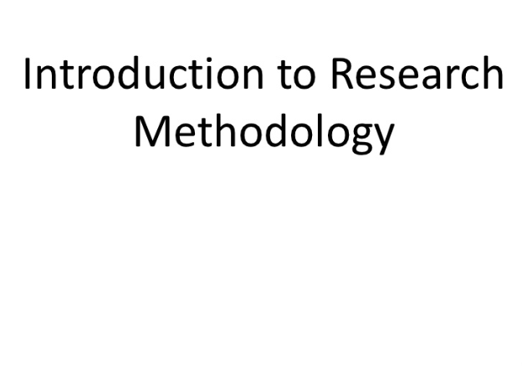

Slide 2
Meaning of Research
The systematic method consisting of articulating the problem, formulating a hypothesis, collecting the facts or data, analysing the facts and reaching certain conclusion either in the form of solutions towards the concerned problem or in certain generalizations for some theoretical formulation
Is the pursuit of truth with help of study, observations, comparison and experiment.

Slide 3
Research Methodology
The process used to collect information and data for the purpose of making business decisions.
The methodology may include publication research, interviews, surveys and other research techniques, and could include both present and historical information.

Slide 4
OBJECTIVES OF RESEARCH
1. To gain familiarity with a phenomenon or to achieve new insights into it (studies with this object in view are termed as exploratory or formulative research studies);
2. To portray accurately the characteristics of a particular individual, situation or a group(studies with this object in view are known as descriptive research studies);
3. To determine the frequency with which something occurs or with which it is associated with something else (studies with this object in view are known as diagnostic research studies);
4. To test a hypothesis of a causal relationship between variables (such studies are known as hypothesis-testing research studies).

Slide 5
OBJECTIVES OF RESEARCH
The purpose of research is to discover answers to questions through the application of scientific procedures.
The main aim of research is to find out the truth which is hidden and which has not been discovered as yet.
Though each research study has its own specific purpose, we may think of research objectives as falling into a number of following broad groupings:

Slide 6
Motivation in research
What makes people to undertake research? This is a question of fundamental importance. The possible motives for doing research may be either one or more of the following:
1. Desire to get a research degree along with its consequential benefits;
2. Desire to face the challenge in solving the unsolved problems, i.e., concern over practical problems initiates research;
3. Desire to get intellectual joy of doing some creative work;
4. Desire to be of service to society;
5. Desire to get respectability.

Slide 7
Types of research
The basic types of research are as follows:
Descriptive vs. Analytical: Descriptive research includes surveys and fact-finding enquiries of different kinds. The major purpose of descriptive research is description of the state of affairs as it exists at present. In analytical research, the researcher has to use facts or information already available, and analyze these to make a critical evaluation of the material.
(ii) Applied vs. Fundamental: Research can either be applied (or action) research or fundamental (to basic or pure) research.
Applied research aims at finding a solution for an immediate problem facing a society or an industrial/business organisation, whereas fundamental research is mainly concerned with generalisations and with the formulation of a theory.
“Gathering knowledge for knowledge’s sake is termed ‘pure’ or ‘basic’ research.” Research concerning some natural phenomenon or relating to pure mathematics are examples of fundamental research.

Slide 8
Types of research
(iii) Quantitative vs. Qualitative: Quantitative research is based on the measurement of quantity or amount. It is applicable to phenomena that can be expressed in terms of quantity.
Qualitative research, on the other hand, is concerned with qualitative phenomenon, i.e., phenomena relating to or involving quality or kind.
For instance, when we are interested in investigating the reasons for human behaviour (i.e., why people think or do certain things),
we quite often talk of ‘Motivation Research’, an important type of qualitative research.

Slide 9
Types of research
(iv) Conceptual vs. Empirical: Conceptual research is that related to some abstract ideas or theory.
It is generally used by philosophers and thinkers to develop new concepts or to reinterpret existing ones.
On the other hand, empirical research relies on experience or observation alone, often without due regard for system and theory.
It is data-based research, coming up with conclusions which are capable of being verified by observation or experiment.

Slide 10
Research Approaches
There are two basic approaches to research, that is,
quantitative approach and the qualitative approach.
The former involves the generation of data in quantitative form which can be subjected to rigorous quantitative analysis in a formal and rigid fashion.
This approach can be further sub-classified into inferential, experimental and simulation approaches to research

Slide 11
Qualitative approach to research is concerned with subjective assessment of attitudes, opinions and behaviour.
Research in such a situation is a function of researcher’s insights and impressions.
Such an approach to research generates results either in non-quantitative form or in the form which are not subjected to rigorous quantitative analysis

Slide 12
Research Methods versus Methodology
Research methods may be understood as all those methods/techniques that are used for conduction of research.
Research methods or techniques*, refer to the methods the researchers use in performing research operations.
In other words, all those methods which are used by the researcher during the course of studying his research problem are termed as research methods.

Slide 13
Research Methods versus Methodology
Research methods can be put into the following
three groups:
1. In the first group we include those methods which are concerned with the collection of data. These methods will be used where the data already available are not sufficient to arrive at the required solution;
2. The second group consists of those statistical techniques which are used for establishing relationships between the data and the unknowns;
3. The third group consists of those methods which are used to evaluate the accuracy of the results obtained.

Slide 14
Research methods
Research methodology is a way to systematically solve the research problem. It may be understood as a science of studying how research is done scientifically.
In it we study the various steps that are generally adopted by a researcher in studying his research problem along with the logic behind them.
It is necessary for the researcher to know not only the research methods/techniques but also the methodology.

Slide 15
Importance of Knowing How Research is Done
The study of research methodology gives the student the necessary training in gathering material and arranging or card-indexing them, participation in the field work when required.
Training in techniques for the collection of data appropriate to particular problems, in the use of statistics, questionnaires and controlled experimentation and in recording evidence, sorting it out and interpreting it.

Slide 16
Importance of knowing the methodology of research or how research is done stems from the following considerations:
The knowledge of methodology provides good training specially to the new research worker and enables him to do better research. It helps him to develop disciplined thinking to observe the field objectively.
(ii ) Knowledge of how to do research will inculcate the ability to evaluate and use research results with reasonable confidence;
the knowledge of research methodology is helpful in various fields such as government or business administration, community development and social work where persons are increasingly called upon to evaluate and use research results for action.

Slide 17
(iii) The knowledge of research methodology provides tools to look at things in life objectively.
(iv) The knowledge of methodology helps the consumer of research
results to evaluate them and enables him to take rational decisions.

Slide 18
WHAT YOU CAN DO WITH RESEARCH
So what can we use research to do in order to gain this new knowledge?
Some of the ways it can be used one to:
Categorise. This involves forming a typology of objects, events
or concepts, i.e. a set of names or ‘boxes’ into which these can
be sorted. This can be useful in explaining which ‘things’ belong
together and how.
Describe. Descriptive research relies on observation as a means of collecting data. It attempts to examine situations in order to establish what is the norm, i.e. what can be predicted to happen again under the same circumstances.

Slide 19
Explain. This is a descriptive type of research specifically designed
to deal with complex issues. It aims to move beyond ‘just getting the facts’ in order to make sense of the myriad other elements involved, such as human, political, social, cultural and contextual.
Evaluate. This involves making judgements about the quality of objects or events. Quality can be measured either in an absolute sense or on a comparative basis. To be useful, the methods of evaluation must be relevant to the context and intentions of the research.
Compare. Two or more contrasting cases can be examined to highlight differences and similarities between them, leading to a better understanding of phenomena.
Correlate. The relationships between two phenomena are investigated
to see whether and how they influence each other.

Slide 20
The relationship might be just a loose link at one extreme or a direct
link when one phenomenon causes another. These are measured as levels of association.
Predict. This can sometimes be done in research areas where correlations are already known. Predictions of possible future behaviour or events are made on the basis that if there has been a strong relationship between two or more characteristics or events in the past, then these should exist in similar circumstances in the future, leading to predictable outcomes.
Control. Once you understand an event or situation, you may be able to find ways to control it. For this you need to know what the cause and effect relationships are and that you are capable of exerting control over the vital ingredients. All of technology relies on this ability to control.

Slide 21
Research Process
Research process consists of series of actions or steps necessary to effectively carry out research and the desired sequencing of these steps.

Slide 22
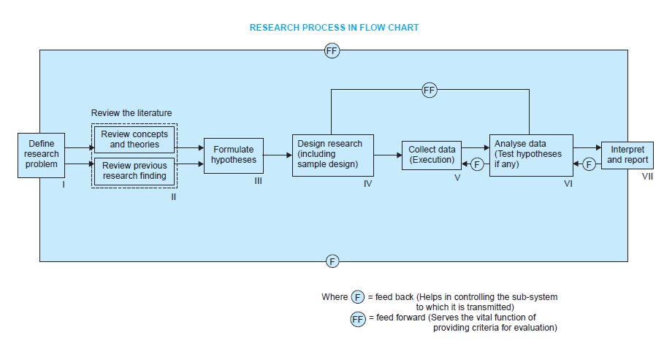
Research Process
The chart shown in Figure 1.1 well illustrates a research process.

Slide 23
Research Process
The following order concerning various steps provides a useful procedural guideline regarding the research process:
(1) formulating the research problem;
(2) extensive literature survey;
(3) developing the hypothesis;
(4) preparing the research design;
(5) determining sample design;
(6) collecting the data;
(7) execution of the project;
(8) analysis of data;
(9) hypothesis testing;
(10) generalizations and interpretation,
(11) preparation of the report or presentation of the results,
i.e., formal write-up of conclusions reached.

Slide 24
Research Process
Formulating the research problem: There are two types of research problems, ie., those which relate to states of nature and those which relate to relationships between variables.
At the very outset the researcher must single out the problem he wants to study, i.e., he must decide the general area of interest or aspect of a subject-matter that he would like to inquire into.
2. Extensive literature survey: Once the problem is formulated, a brief summary of it should be written down. It is compulsory for a research worker writing a thesis for a Ph.D. degree to write a synopsis of the topic and submit it to the necessary Committee or the Research Board for approval.
At this juncture the researcher should undertake extensive literature survey connected with the problem.

Slide 25
3. Development of working hypotheses: After extensive literature survey, researcher should state in clear terms the working hypothesis or hypotheses.
Working hypothesis is tentative assumption made in order to draw out and test its logical or empirical consequences.
As such the manner in which research hypotheses are developed is particularly important since they provide the focal point for research.

Slide 26
How does one go about developing working hypotheses?
The answer is by using the following approach:
(a) Discussions with colleagues and experts about the problem, its origin and the objectives in seeking a solution;
(b) Examination of data and records, if available, concerning the problem for possible trends, peculiarities and other clues;
(c) Review of similar studies in the area or of the studies on similar problems;
(d) Exploratory personal investigation which involves original field interviews on a limited scale with interested parties and individuals with a view to secure greater insight into the practical aspects of the problem.

Slide 27
4. Preparing the research design: The function of research design is to provide for the collection of relevant evidence with minimal expenditure of effort, time and money. But how all these can be achieved depends mainly on the research purpose.
Research purposes may be grouped into four categories,
(i) Exploration,
(ii) Description,
(iii) Diagnosis,
(iv) Experimentation.

Slide 28
The preparation of the research design, appropriate for a particular research problem, involves usually the consideration of the following:
(i) the means of obtaining the information;
(ii) the availability and skills of the researcher and his staff (if any);
(iii) explanation of the way in which selected means of obtaining information will be organized and the reasoning leading to the selection;
(iv) the time available for research; and
(v) the cost factor relating to research, i.e., the finance available for the purpose.

Slide 29
5. Determining sample design: The researcher must decide the way of selecting a sample or what is popularly known as the sample design.
In other words, a sample design is a definite plan determined before any data are actually collected for obtaining a sample from a given population.
6. Collecting the data: There are several ways of collecting the appropriate data which differ considerably in context of money costs, time and other resources at the disposal of the researcher.
Primary data can be collected either through experiment or through survey. If the researcher conducts an experiment, he observes some quantitative measurements, or the data, with the help of which he examines the truth contained in his hypothesis.

Slide 30
But in the case of a survey, data can be collected by any one or more of the following ways:
By observation: This method implies the collection of information by way of investigator’s own observation, without interviewing the respondents. The information obtained relates to what is currently happening and is not complicated by either the past behaviour or future intentions or attitudes of respondents.
Through personal interview: The investigator follows a rigid procedure and seeks answers to a set of pre-conceived questions through personal interviews.
Through telephone interviews: This method of collecting information involves contacting the respondents on telephone itself.

Slide 31
(iv) By mailing of questionnaires: The researcher and the respondents do come in contact with each other if this method of survey is adopted. Questionnaires are mailed to the respondents with a request to return after completing the same.
(v) Through schedules: Under this method the enumerators are appointed and given training. They are provided with schedules containing relevant questions. These enumerators go to respondents with these schedules. Data are collected by filling up the schedules by
enumerators on the basis of replies given by respondents.

Slide 32
7. Execution of the project: Execution of the project is a very important step in the research process.
If the execution of the project proceeds on correct lines, the data to be collected would be adequate and dependable.
The researcher should see that the project is executed in a systematic manner and in time.
8. Analysis of data: After the data have been collected, the researcher turns to the task of analyzing them.
The analysis of data requires a number of closely related operations such as establishment of categories, the application of these categories to raw data through coding, tabulation and then drawing statistical inferences.

Slide 33
9. Hypothesis-testing: After analysing the data as stated above, the researcher is in a position to test the hypotheses, if any, he had formulated earlier.
Do the facts support the hypotheses or they happen to be contrary? This is the usual question which should be answered while testing hypotheses.
10. Generalisations and interpretation: If a hypothesis is tested and upheld several times, it may be possible for the researcher to arrive at generalisation, i.e., to build a theory.
As a matter of fact, the real value of research lies in its ability to arrive at certain generalisations.
If the researcher had no hypothesis to start with, he might seek to explain his findings on the basis of some theory.

Slide 34
11. Preparation of the report or the thesis: Finally, the researcher has to prepare the report of what has been done by him.
Writing of report must be done with great care keeping in view the following:
The layout of the report should be as follows:
(i) the preliminary pages; (ii) the main text, and (iii) the end matter.
i) In its preliminary pages the report should carry title and date followed by acknowledgements and foreword. Then there should be a table of contents followed by a list of tables and list of graphs and charts, if any, given in the report.

Slide 35
ii) The main text of the report should have the following parts:
(a) Introduction: It should contain a clear statement of the objective of the research and an explanation of the methodology adopted in accomplishing the research. The scope of the study along with various limitations should as well be stated in this part.
(b) Summary of findings: After introduction there should be a statement of findings and recommendations in non-technical language. If the findings are extensive, they should be summarised.
(c) Main report: The main body of the report should be presented in logical sequence and broken-down into readily identifiable sections.
(d) Conclusion: Towards the end of the main text, researcher should again put down the results of his research clearly and precisely.

Slide 36
iii) At the end of the report, appendices should be enlisted in respect of all technical data.
1.Bibliography, i.e., list of books, journals, reports, etc., consulted, should also be given in the end. Index should also be given specially in a published research report.
2. Report should be written in a concise and objective style in simple language avoiding vague expressions such as ‘it seems,’ ‘there may be’, and the like.
3. Charts and illustrations in the main report should be used only if they present the information more clearly and forcibly.
4. Calculated ‘confidence limits’ must be mentioned and the various constraints experienced in conducting research operations may as well be stated.

Slide 37
Criteria of Good Research
Whatever may be the types of research works and studies, one thing that is important is that they all meet on the common ground of scientific method employed by them. Scientific research should satisfy the following criteria:
1. The purpose of the research should be clearly defined and common concepts be used.
2. The research procedure used should be described in sufficient detail to permit another
researcher to repeat the research for further advancement, keeping the continuity of what has already been attained.
3. The procedural design of the research should be carefully planned to yield results that are as objective as possible.
4. The researcher should report with complete frankness, flaws in procedural design and
estimate their effects upon the findings.

Slide 38
5. The analysis of data should be sufficiently adequate to reveal its significance and the methods of analysis used should be appropriate. The validity and reliability of the data should be checked carefully.
6. Conclusions should be confined to those justified by the data of the research and limited to those for which the data provide an adequate basis.
7. Greater confidence in research is warranted if the researcher is experienced, has a good reputation in research and is a person of integrity.

Slide 39
In other words, we can state the qualities of a good research as under:
1. Good research is systematic: It means that research is structured with specified steps to be taken in a specified sequence in accordance with the well defined set of rules. Systematic characteristic of the research does not rule out creative thinking but it certainly does reject the use of guessing and intuition in arriving at conclusions.
2. Good research is logical: This implies that research is guided by the rules of logical
reasoning and the logical process of induction and deduction are of great value in carrying out research.
Induction is the process of reasoning from a part to the whole whereas deduction is the process of reasoning from some premise to a conclusion which follows from that very premise.
Logical reasoning makes research more meaningful in the context of decision making.

Slide 40
3.Good research is empirical: It implies that research is related basically to one or more aspects of a real situation and deals with concrete data that provides a basis for external
validity to research results.
4. Good research is replicable: This characteristic allows research results to be verified by replicating the study and thereby building a sound basis for decisions.

Slide 41
Problem encountered by researches
Lack of scientific training in methodology of research
Insufficient interaction
Need for generating the confidence that the information/data obtained from a patient will not be misused
Research studies overlapping one another are undertaken quite often for want of adequate information
Timely and adequate secretarial assistance, including computer assistance
Library management & functioning is not satisfactory at many places
Difficulty of timely availability of published data
Problem of conceptualization

